Slide 1
Lecture 11: Objects, Lists and Sequences (Part 1)
Understand sequences, list, and list methods.
Kok-Seng Wong | 2021

Slide 2

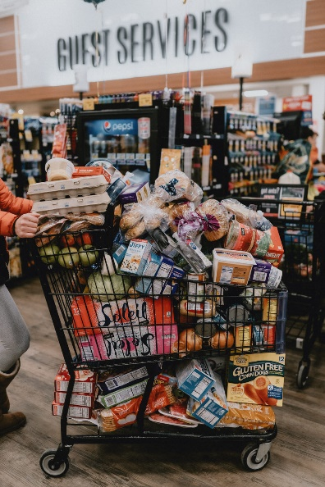
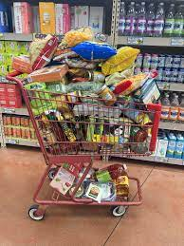
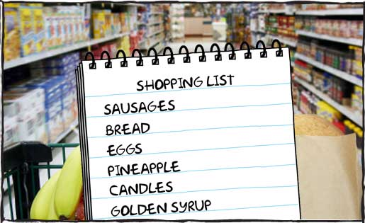
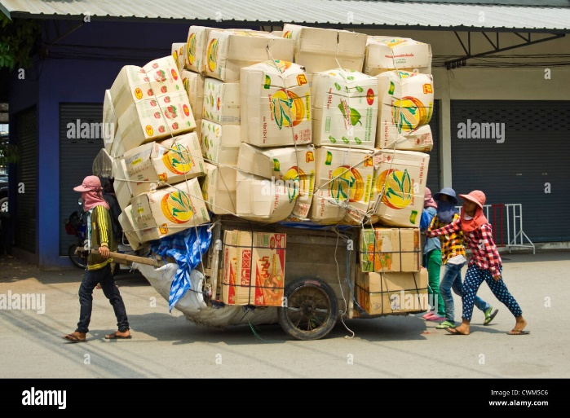
Motivation example 1
Reality
[source]

Slide 3

Motivation example 2
[source]

Slide 4
Learning outcomes
Upon the completion of this lecture, students will be able to:
use indexing and slicing to access list elements in Python.
manipulate lists that hold a collection of objects with the built-in methods.
understand operations in lists concatenation and repetition.
explain the differences between strings and lists.

Slide 5
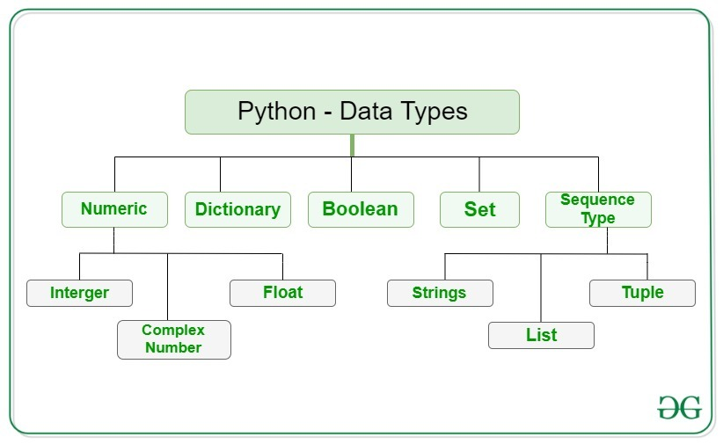
Lists are sequence types
Sequence types: program can iterate over them (iterables).
[source]

Slide 6
Python lists
One of the four built-in data structures ( together with tuples, dictionaries, and set) in Python.
Used to store ordered items.
Can store different types of items – but not common.
Use a square brackets [] and commas (,) to separate the elements.
my_enemy = ["Thomas", "Billy", "Nam"]
Empty List
my_friend = []

Slide 7
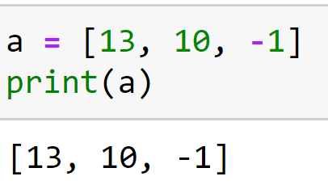
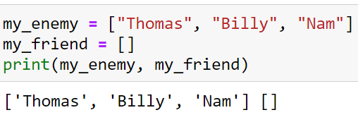
Lists - outputs

Slide 8
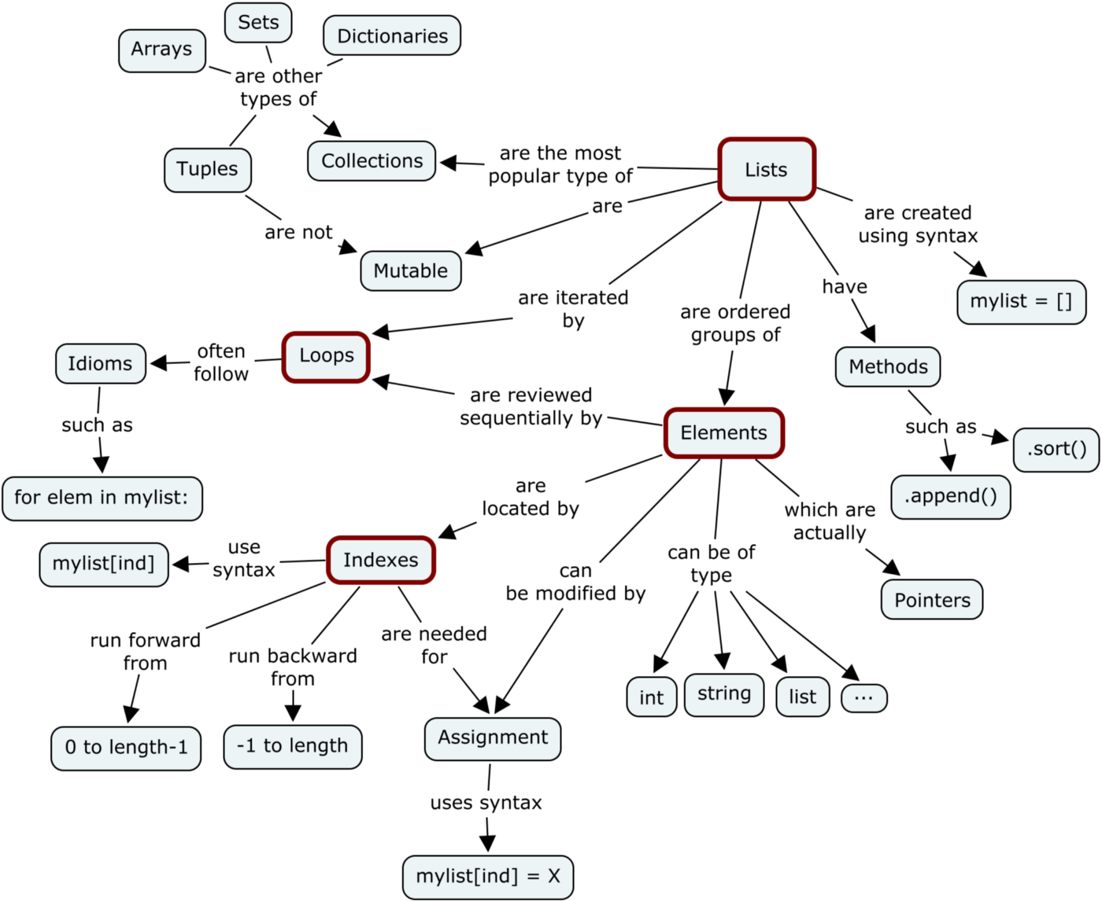
Python lists - mutable
https://medium.com/@meghamohan/mutable-and-immutable-side-of-python-c2145cf72747

Slide 9
Identical vs. Equivalent
>>> Thomas = "professor"
>>> Billy = "professor"
>>> Thomas is Billy
True
>>> x = ["Thomas", "Billy"]
>>> y = ["Thomas", "Billy"]
>>> x is y
False
x
Thomas
["Thomas","Billy"]
"professor"
Billy
y
["Thomas","Billy"]

Slide 10
If two objects are identical, they are also equivalent, but if they are equivalent, they are not necessarily identical.

Slide 11
Strings vs Lists
string
list
s = "mouse"
Put characters in quotes " "
Access characters with []
s[1]="m"
s[6]-> error (why?)
s[1:3]="ou"
len(s)=5
x =[1,3,5,9,10,22]
Put elements inside[], separate by commas
Access elements with []
x[3]=19
x[2:5]=[5,19,10]
len(x)=6
0 | 1 | 2 | 3 | 4
0 | 1 | 2 | 3 | 4 | 5
m | o | u | s | e
1 | 3 | 5 | 9 | 10 | 22
Mutable

Slide 12

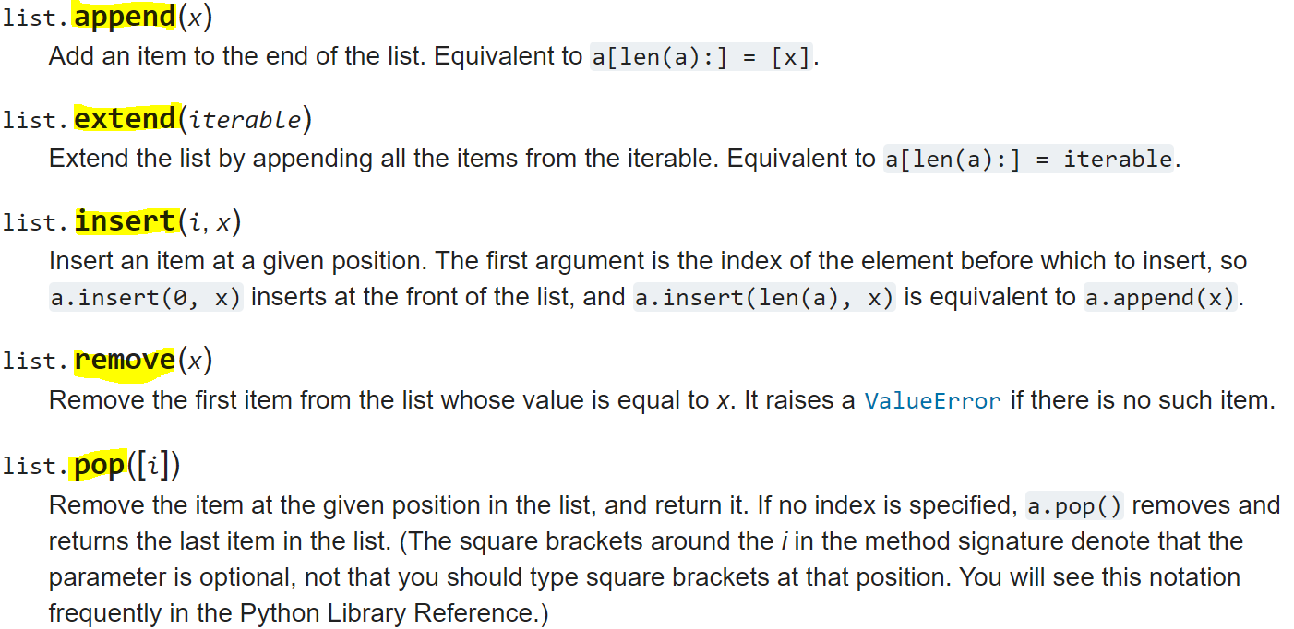
List data type methods
https://docs.python.org/3/tutorial/datastructures.html

Slide 13
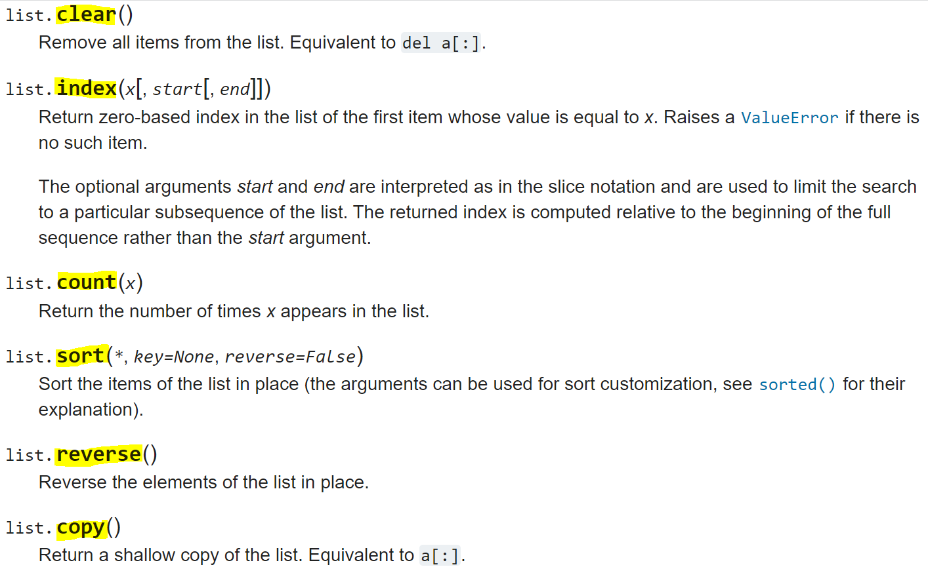
List data type methods
https://docs.python.org/3/tutorial/datastructures.html

Slide 14
Indices and ordering
>>> a = [13, 10, -1]
>>> a
[13, 10, -1]
>>> len(a)
3
>>> a[0]
13
>>> a[4]
Traceback (most recent call last):
File "<stdin>", line 1, in <module>
IndexError: list index out of range
0 | 1 | 2
13 | 10 | -1
3 elements

Slide 15
Changing elements
0 | 1 | 2
>>> a = [13, 10, -1]
13 | 10 | -1

Slide 16
Changing elements
0 | 1 | 2
>>> a = [13, 10, -1]
>>> a[1] = 20
13 | 20 | -1

Slide 17
Changing elements
0 | 1 | 2
>>> a = [13, 10, -1]
>>> a[1] = 20
>>> a
[13, 20, -1]
13 | 20 | -1

Slide 18
Changing elements
0 | 1 | 2 | 3
>>> a = [13, 10, -1]
>>> a[1] = 20
>>> a
[13, 20, -1]
>>> a.append(9)
13 | 10 | -1 | 9
append()- appends an element to the end of the list

Slide 19
Changing elements
0 | 1 | 2 | 3
>>> a = [13, 10, -1]
>>> a[1] = 20
>>> a
[13, 20, -1]
>>> a.append(9)
>>> a
[13, 20, -1, 9]
13 | 10 | -1 | 9

Slide 20
Changing elements
0 | 1 | 2
>>> a = [13, 10, -1]
>>> a[1] = 20
>>> a
[13, 20, -1]
>>> a.append(9)
>>> a
[13, 20, -1, 9]
>>> a.pop()
9
13 | 10 | -1
pop()- removes the element at the specified position (default value is -1)

Slide 21
Changing elements
0 | 1 | 2
>>> a = [13, 10, -1]
>>> a[1] = 20
>>> a
[13, 20, -1]
>>> a.append(9)
>>> a
[13, 20, -1, 9]
>>> a.pop()
9
>>> a
[13, 20, -1]
13 | 10 | -1

Slide 22
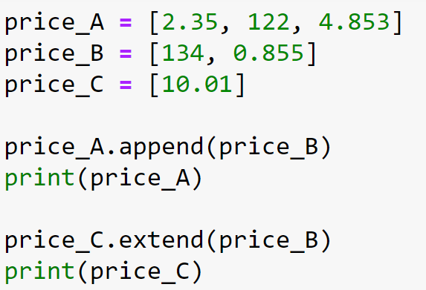

Append vs extend
A list is an object!

Slide 23
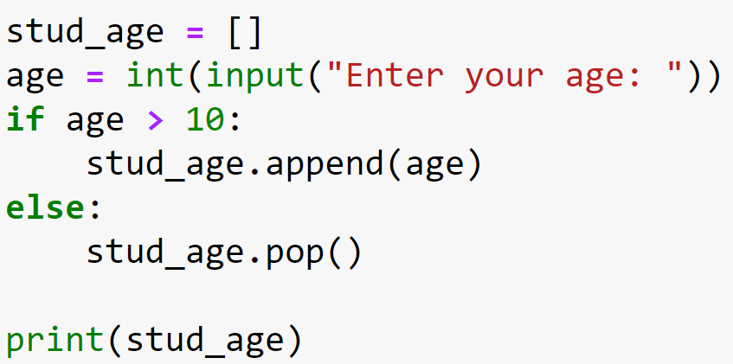
Class practice

Slide 24
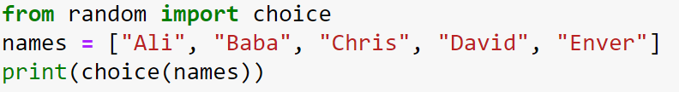
Class practice

Slide 25
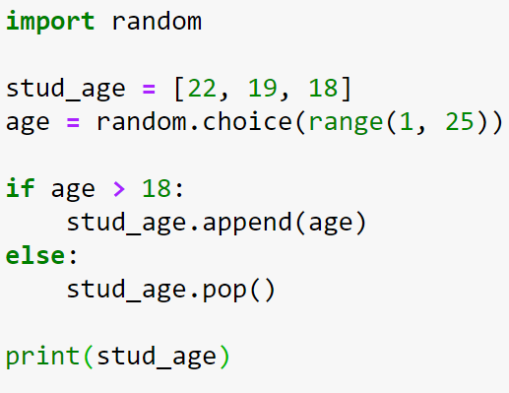
Class practice

Slide 26
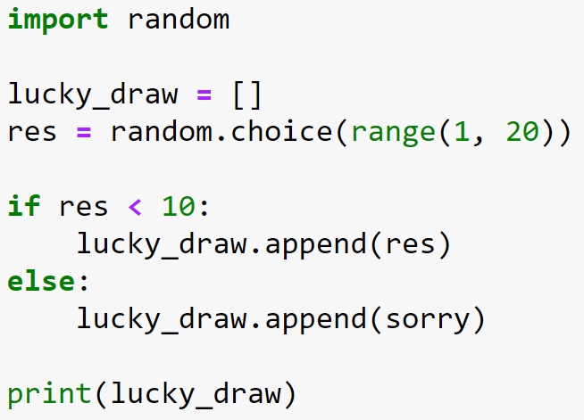
Class practice

Slide 27
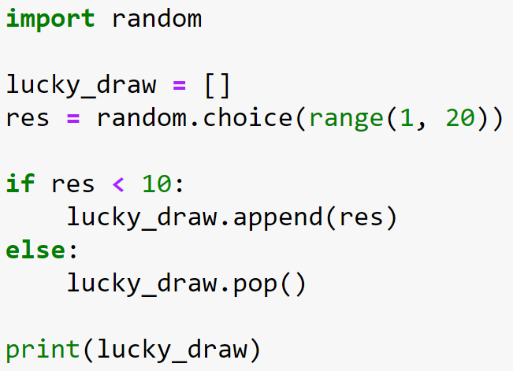
Class practice

Slide 28
Insert element(s)
>>> a = [13, 10, -1]
>>> a.insert(1,20)
>>> a
[13, 20, 10, -1]
>>> a[1:3] = [2, 8]
>>> a
[13, 2, 8, -1]
insert()- add an item at the specified position
To replace the original elements

Slide 29
Lists concatenation
0 | 1 | 2
0 | 1 | 2
>>> a = [13, 10, -1]
>>> b = [4, 23, 12]
>>> a + b
[13, 10, -1, 4, 23, 12]
a
13 | 10 | -1
4 | 23 | 12
b
0 | 1 | 2
3 | 4 | 5
a+b
13 | 10 | -1
4 | 23 | 12
0 | 1 | 2
3 | 4
>>> print(a + [7, 19])
[13, 10, -1, 7, 19]
a+[7, 19]
13 | 10 | -1
7 | 19
>>> print(7 + [7, 19])
Traceback (most recent call last):
File "<stdin>", line 1, in <module>
TypeError: unsupported operand type(s) for +: 'int' and 'list'

Slide 30
Lists Repetition
>>> list_1 = [1, 3, 5]
>>> list_1 * 4
[1, 3, 5, 1, 3, 5, 1, 3, 5, 1, 3, 5]
>>> print([0] * 3)
[0, 0, 0]
>>> list_1 * 2 + [8,9]
[1, 3, 5, 1, 3, 5, 8, 9]
>>> list_1 * 2 + [8,9] * 3
[1, 3, 5, 1, 3, 5, 8, 9, 8, 9, 8, 9]
>>> (list_1 +[8,9]) * 3
[1, 3, 5, 8, 9, 1, 3, 5, 8, 9, 1, 3, 5, 8, 9]

Slide 31
Count and index
>>> friends = ["James", "Ali", "Michelle", "Ben"]
>>> friends.count("Ali")
1
>>> friends.index("Ben")
3
>>> friends.index("Baba")
Traceback (most recent call last):
File "<stdin>", line 1, in <module>
ValueError: 'Baba' is not in list

Slide 32
transform list to strings
list(s):returns a list with every character from s
split(): splits a string on a character parameter
"".join(): turns a list of characters into a string
>>> s1 = "Hello"
>>> list(s1)
['H', 'e', 'l', 'l', 'o']
>>> s2 = "I<3U"
>>> s2.split("3")
['I<', 'U']
>>> s3 = ['H', 'e', 'l', 'l', 'o']
>>> "".join(s3)
'Hello'
>>> s4 = ['ALI', 'BABU']
>>> "*".join(s4)
'ALI*BABU'

Slide 33
sorting elements in a list
sorted():create a new list containing a sorted version of the list it is given (can assign the returned data to a new variable)
sort():modify the list it is called on
>>> fruit_list = ["carrot", "banana", "apple", "eggfruit", "durian"]
>>> sorted(fruit_list)
['apple', 'banana', 'carrot', 'durian', 'eggfruit']
>>> fruit_list
['carrot', 'banana', 'apple', 'eggfruit', 'durian']
>>> new_list = sorted(fruit_list)
>>> new_list
['apple', 'banana', 'carrot', 'durian', 'eggfruit']
>>> fruit_list.sort()
>>> fruit_list
['apple', 'banana', 'carrot', 'durian', 'eggfruit']

Slide 34
Sort strings using sorted()
>>> str = "Ali Baba"
>>> sorted(str)
[' ', 'A', 'B', 'a', 'a', 'b', 'i', 'l']
>>> my_id = "25443234345"
>>> sorted(my_id)
['2', '2', '3', '3', '3', '4', '4', '4', '4', '5', '5']
>>> "".join(my_id)
'25443234345'

Slide 35
Class practice
>>> str2 = "Was it a cat I saw?“
>>> sorted_str2 = sorted(str2.split())
>>> sorted_str2
>>> " ".join(sorted_str2)

Slide 36
Reverse elements in a list
reverse():
Use sorted() with reverse argument
>>> fruit_list = ["carrot", "banana", "apple",
"eggfruit", "durian"]
>>> fruit_list.reverse()
>>> fruit_list
['durian', 'eggfruit', 'apple', 'banana', 'carrot']
>>> sorted(fruit_list, reverse=True)
['eggfruit', 'durian', 'carrot', 'banana', 'apple']
More details: https://docs.python.org/3/howto/sorting.html

Slide 37
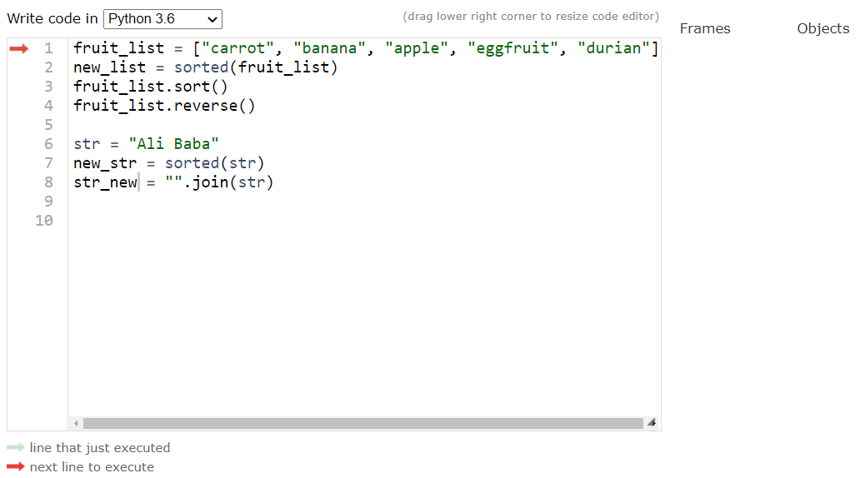
List operations - Python tutor
[Demo]

Slide 38
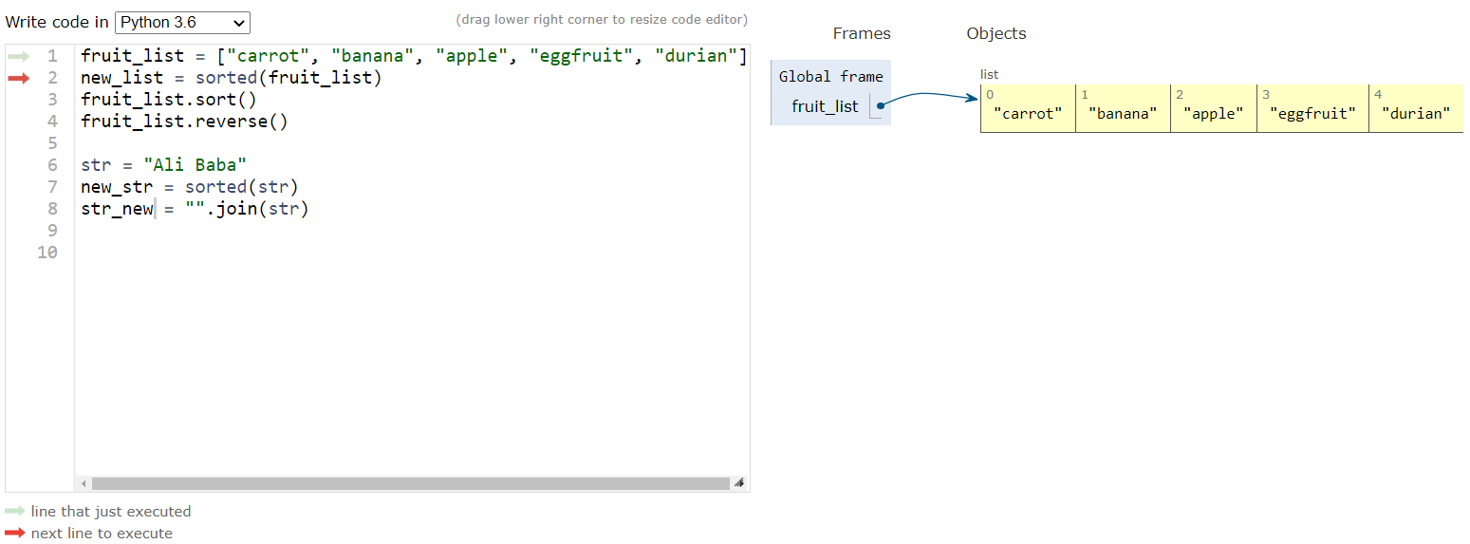
List operations - Python tutor

Slide 39
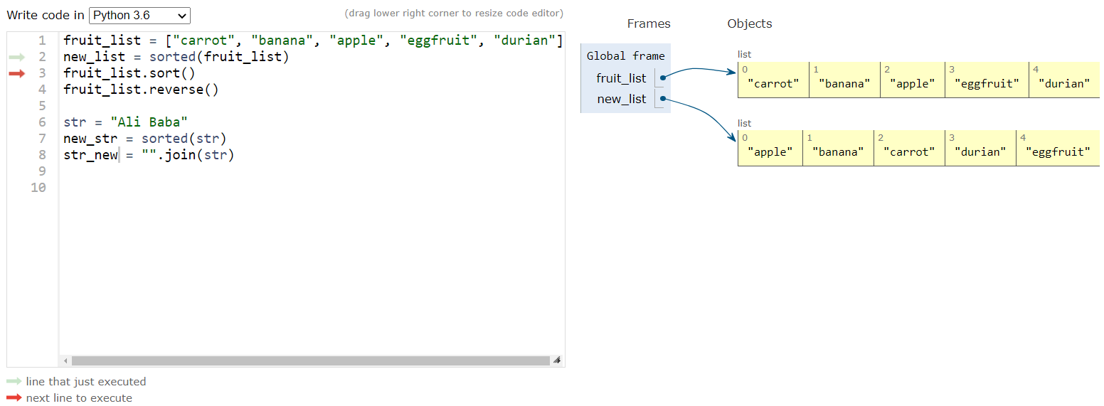
List operations - Python tutor

Slide 40
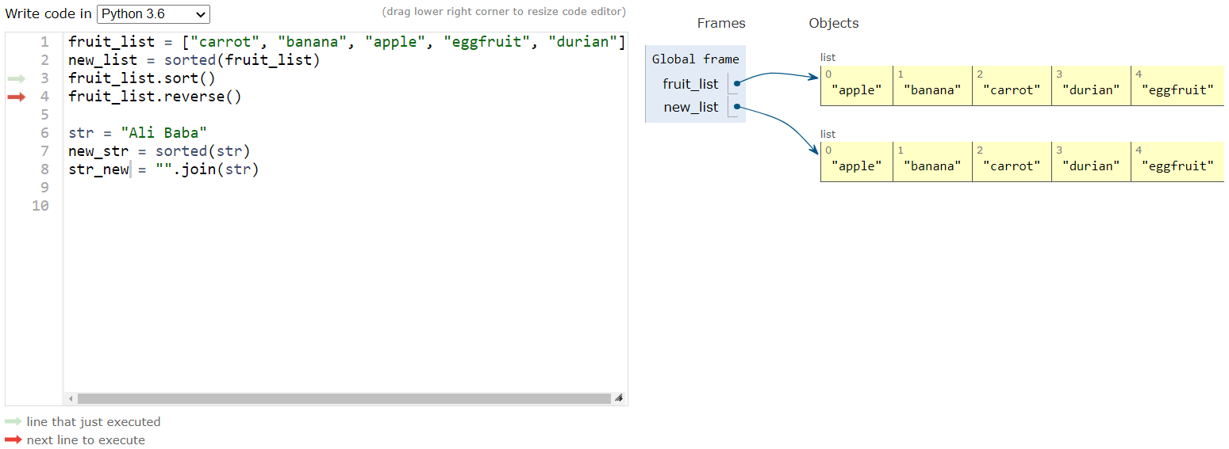
List operations - Python tutor

Slide 41

List operations - Python tutor

Slide 42
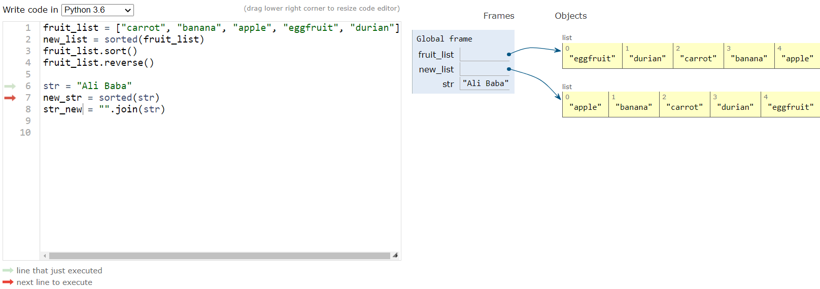
List operations - Python tutor

Slide 43
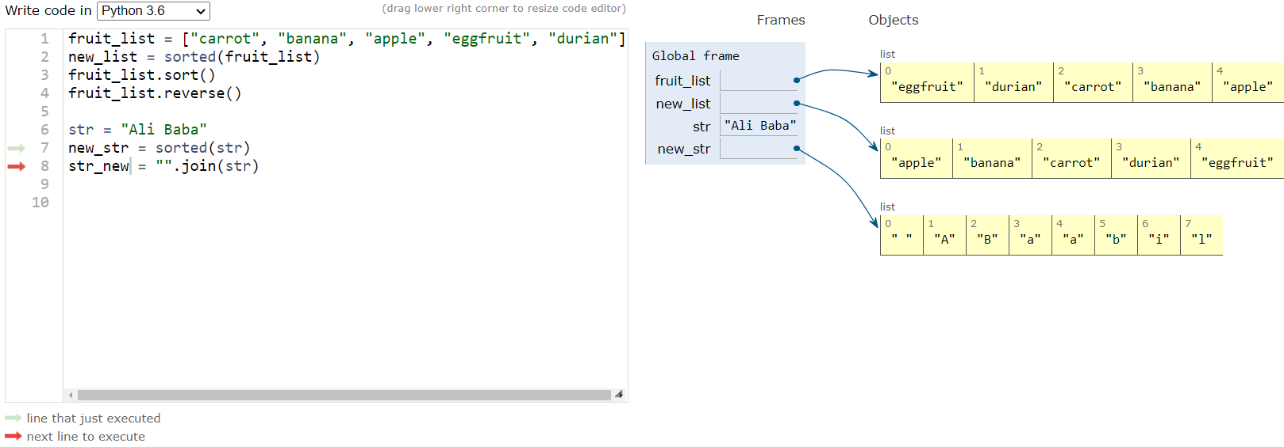
List operations - Python tutor

Slide 44
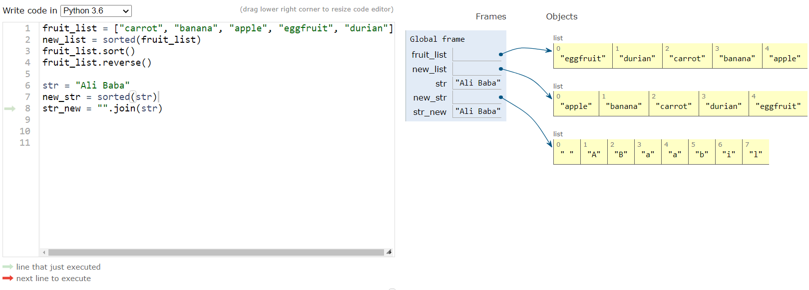
List operations - Python tutor

Slide 45
Class practice
>>> fruit_list = ["carrot", "banana", "apple",
"eggfruit", "durian"]
>>> fruit_list.append("tomato")
>>> fruit_list.pop()
>>> fruit_list.pop()
>>> fruit_list.pop()
>>> fruit_list.sort()
>>> fruit_list.pop()
>>> fruit_list

